Slide 1
A Novel Photobioreactor for Carbon Dioxide Sequestration
Adrija De, Viksit Singh Padam², Sukhda Goyal³, Dr. Akhilendra Pratap Singh⁴
2,4.Department of Mechanical Eng., IIT BHU
3.Department of Chemical Eng.,IIT BHU
Adrija De
Department of Metallurgical Engineering
IIT (BHU), Varanasi

Slide 2
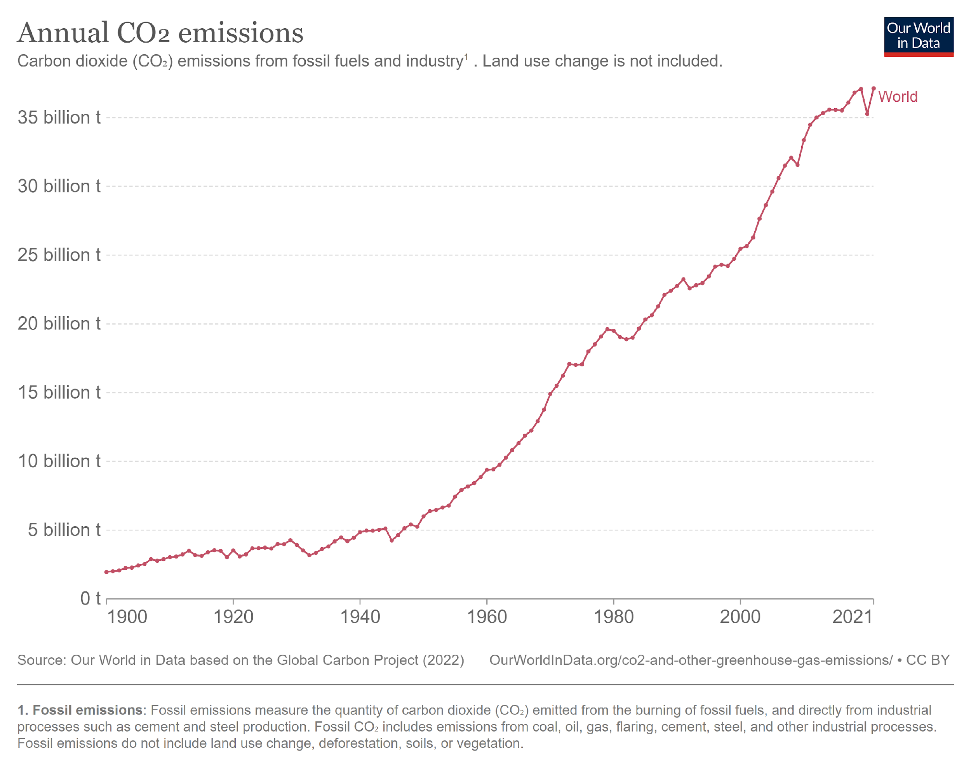
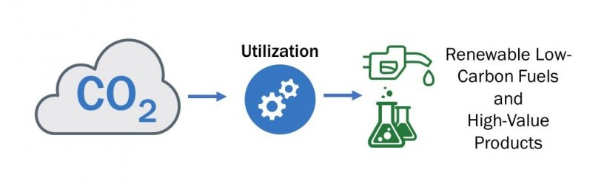
CO₂ : The Major Problem
CO₂ Capture
India accounts for 2.71 billion tons of CO₂ emissions.
Aims to achieve net zero target by 2070.
Biofuel burnt to release CO₂
Efficient Bioreactor Technology
Carbon sequestration is the capturing, removing,
and storing CO₂ from the earth’s atmosphere.
Two CCS centers : IIT Bombay and JNCASR

Slide 3
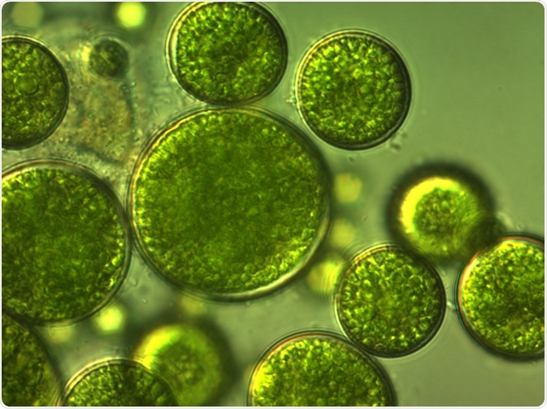
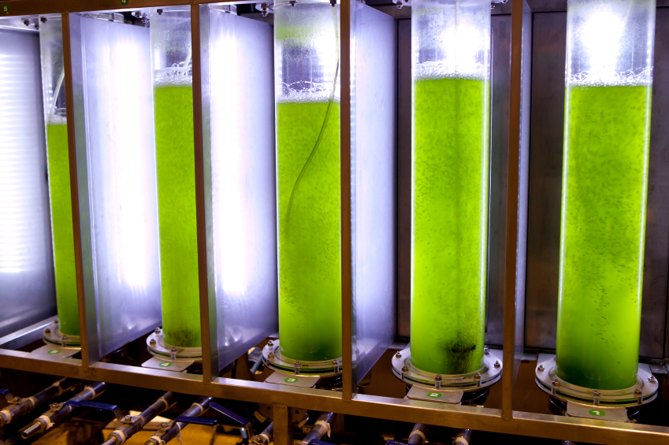
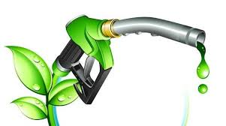
Algae Photobioreactor Technology
Algae are better absorbers of CO2 than trees.
Photobioreactors are mainly used for cultivation of microalgae by regulated supply of CO2,nutrients and light.
During COP26, India launched a mission “Integrated Biorefineries” , collaborating with Netherlands to develop clean energy solutions.
Also plans to invest ₹5000 crore in the biofuel sector by 2025.
With CO₂, N2 and P as nutrients and light for growth
Biofuel extracted by lipid extraction
Fed into Photobioreactor

Slide 4
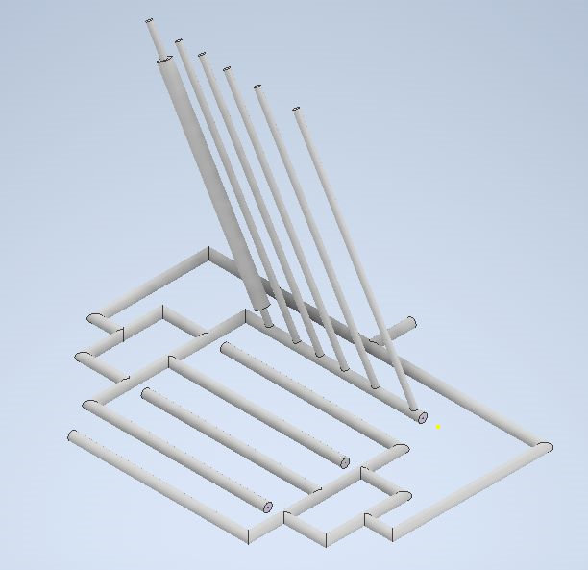
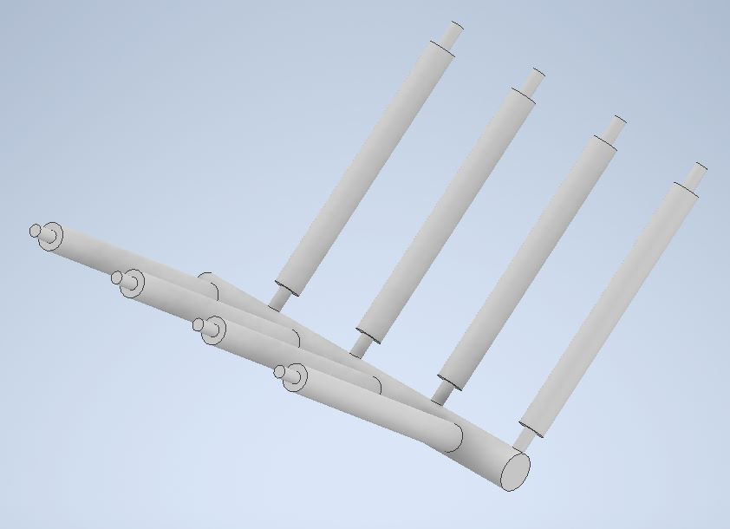
Our First Design
Limitations
Large area requirement.
More number of pipes and other materials required that added to the cost.
Back pressure on the engine
Gas distribution system was not so efficient.
Photobioreactor
Reactor pipe distribution
Inlet
Gas pipe distribution
PB distribution about a single gas pipe
Limitation: Single pipe has too much load

Slide 5
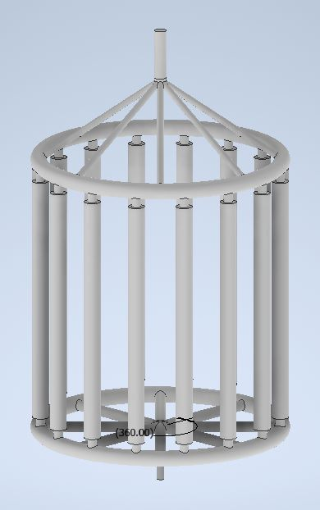
Improved Design
Advantages
Less area required.
Back pressure on engine significantly reduced.
Uniform distribution of gas and sunlight.
Inlet
Gas pipe distribution
Circular Pipe
Limitations
Difficulty to manufacture or weld circular pipe.
Pipe distribution emerging from inlet was difficult to weld or manufacture.
Photobioreactor

Slide 6
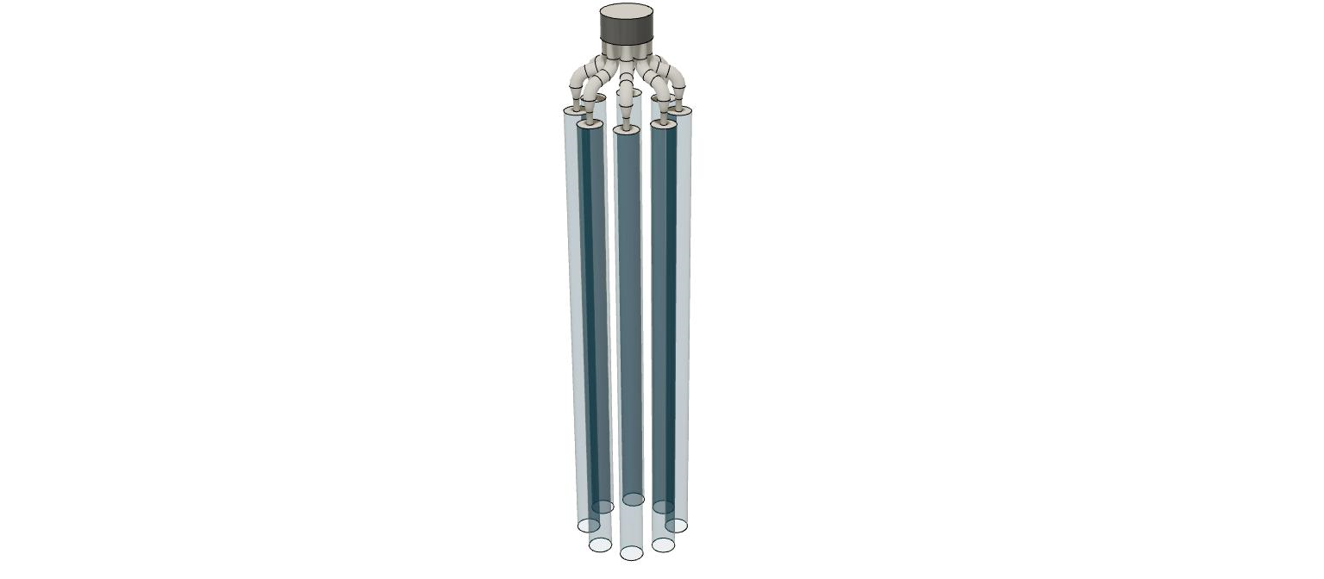
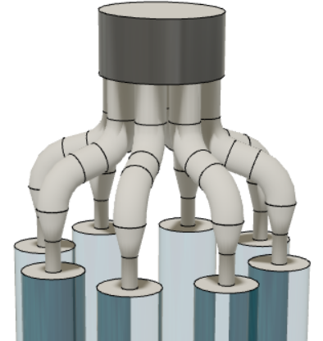
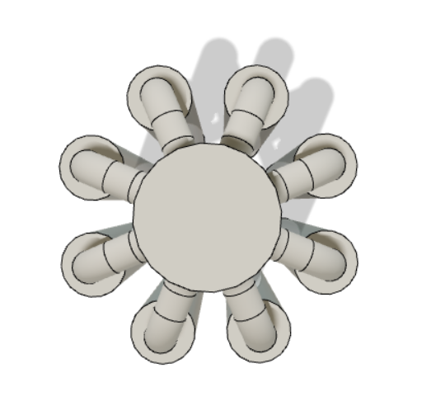
Final Design
Inlet
Gas Pipe Distribution
Advantages
Efficient and uniform gas pipe distribution system.
Back pressure on engine significantly reduced.
Less area required.
No need of circular pipe.
Less number of materials required reducing the cost.
Photobioreactor

Slide 7

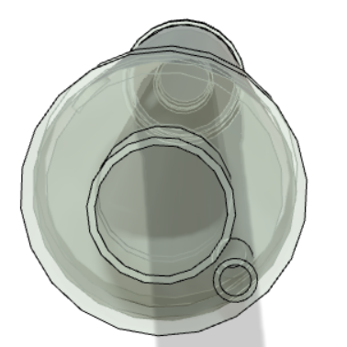
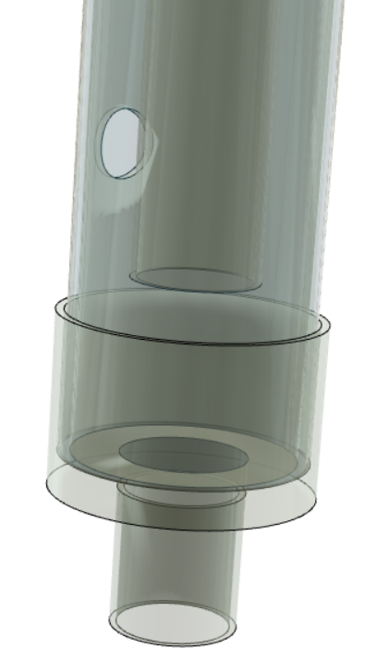
Photobioreactor Design
Inlet
Nutrient Supply Pipe
Dimensions:
Transparent Pipe
1.5m, Dia:4 inch
GI Pipe Dia: 2 inch
GI bends: 2 inch Dia
PVC exit pipe:
0.75 inch Dia
Nutrient Supply Pipe:
0.75 inch Dia
Transparent bioreactor pipe
Inlet
Inlet pipe supplying CO2
Outlet
Aerator
Hole for cleaning bioreactor
Transparent pipe bottom
Stand

Slide 8
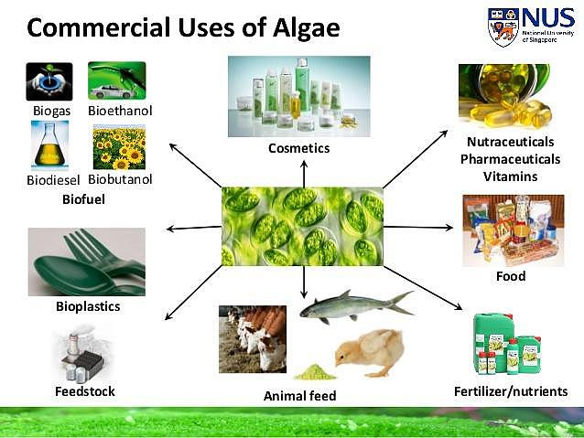
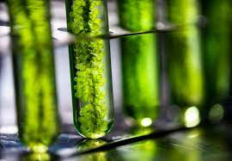
Future Scope and Improvements
Use the algae cultivated to produce biofuel by lipid extraction.
Automation of nutrient supply using sophisticated softwares.
Set up more bioreactors for improved efficiency.
Lack of governmental support for sustainable supply chain norms and solutions, a lack of entrepreneurship assistance, and a lack of subsidies or incentives to encourage competition among bioenergy producers are all significant impediments to the production of biofuels.
Significant research efforts are required in this sector for efficient CO2 absorption and to meet the net zero demand by 2070.

Slide 9


Thanks!

